Slide 1

ML23/24-09 Approve Prediction of Multisequence Learning
Course: Software Engineering
Lecturer: Damir Dobric / Andreas Pech
Presented by:
Saad Jamil Matriculation No. # 1427200
Nabeela Maham Matriculation No. # 1400502
Tanvir Ahmed Matriculation No. # 1386435

Slide 2
OBJECTIVE
Our primary goal is to implement a novel technique in which it will automatically read and learn learning sequences from a file. The sample should read testing subsequences from a separate file. When learning is completed, the trained model should compute the percentage of prediction accuracy of the sequence and save it in the file.

Slide 3
TABLE OF CONTENT
INTRODUCTION
METHODOLOGY
HTM
IMPLEMENTATION (LEARNING & PREDICTION STAGES)
RESULTS
CONCLUSION
REFERENCE

Slide 4
INTRODUCTION
Multi-sequence learning with HTM entails teaching the algorithm to detect and anticipate patterns in multiple input sequences.
To perform multi-sequence learning using HTM, we must first encode the input information into Sparse Distributed Representations (SDRs), which can be accomplished with a scalar encoder.
After the data has been encoded, the spatial pooler generates sparse illustrations of the input sequences that are supplied into the temporal memory element for learning and prediction.
Multisequence learning using HTM is an effective method for identifying and predicting patterns across numerous input sequences.
Scientists and researchers in machine learning collaborate to improve our understanding of the brain in the context of temporal pattern identification. Read a dataset with numerous sequences from a stored file.

Slide 5
HIERARCHICAL TEMPORAL MEMORY (HTM)
The objective of HTM is to emulate the hierarchical structure and learning process of the brain. It is comprised of a network of nodes organized hierarchically, where each node corresponds to a group of neurons in the neocortex. These nodes acquire the ability to identify patterns in sensory information and generate predictions based on their prior experiences.
The neocortex learns and makes predictions by forming a hierarchical structure of columns, each containing a set of neurons that recognize patterns in sensory input. These columns hierarchically communicate with each other, with higher-level columns representing more abstract concepts

Slide 6
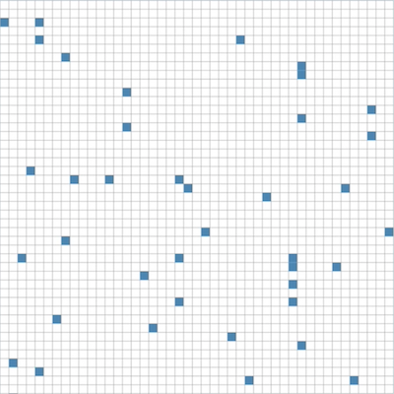
SPARSE DISTRIBUTED REPRESENTATION (SDR)
In the context of HTM, SDRs are used to represent patterns of activity in the network. Each input to the network is transformed into an SDR, which is then processed by the network's hierarchy of nodes to make predictions about future input.
Hawkins and Ahmad proposed that SDRs, which are binary vectors with a small number of active bits (ones) out of a large number of total bits, are a natural way to represent sparse, distributed patterns of activity in the neocortex.

Slide 7
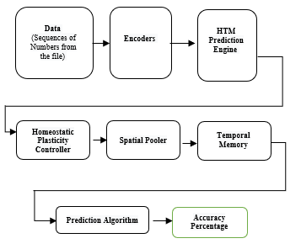
METHODOLOGY
Overview of Sequence Learning:

Slide 8
ENCODER
Encoders compress input data.
They capture key traits while ignoring superfluous information.
Different approaches, such as one-hot encoding, are used depending on the data format.
Particularly important in neural networks, particularly for tasks such as autoencoders.

Slide 9
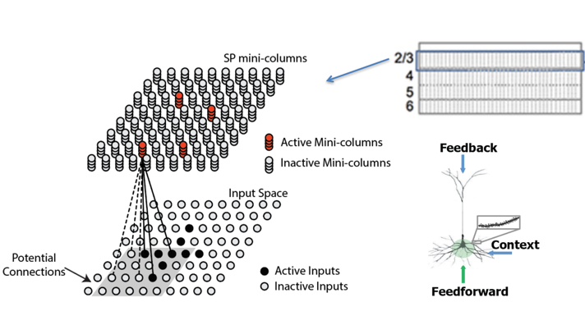
SPATIAL POOLER
The Spatial Pooler is an artificial intelligence component that helps identify patterns in incoming data.
It spatially captures input patterns, resulting in usable representations for further processing.
The Spatial Pooler, which is commonly used in neural networks, improves the network's capacity to perceive and learn from complicated spatial patterns.
By organizing and storing geographical information, it helps AI systems perceive and analyze data more effectively.

Slide 10
TEMPORAL MEMORY
Temporal Storage is an AI concept that focuses on identifying patterns that emerge over time.
It excels in organising and recognising data sequences, which is critical when dealing with time-dependent patterns.
Temporal Memory employs memory systems to predict future patterns based on prior evidence, resulting in more informed decision-making.
When used across several domains, it improves systems' ability to learn and adapt to temporal patterns, such as forecasting trends or sequences.

Slide 11
IMPLEMENTATION: LEARNING AND PREDICTION STAGES
Regarding scientific information:
Acquire datasets and use a scalar encoder for learning the Spatial Pooler.
The Spatial Pooler repeatedly trains each sequence till it reaches a stable state.
HTM, which operates as a memory-based structure, can hold a wide variety of designs and patterns.

Slide 12
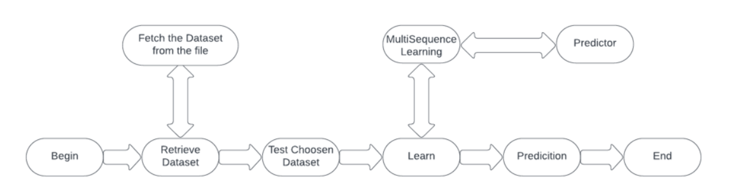
FLOW CHART

Slide 13
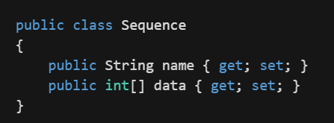
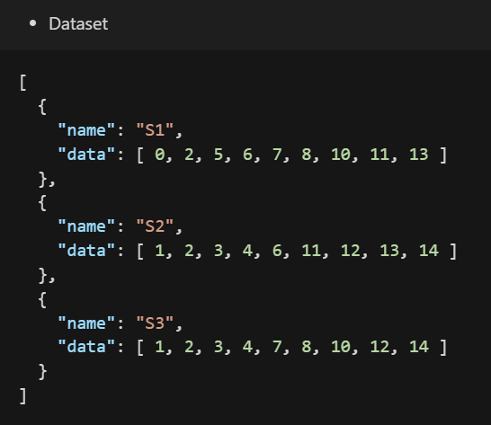
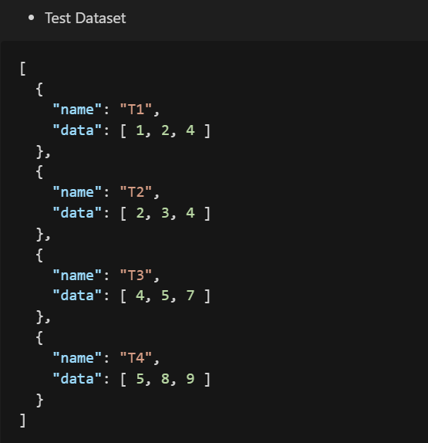
IMPLEMENTATION: DATA MODEL
The sequence represents the model for processing and storing the dataset.

Slide 14
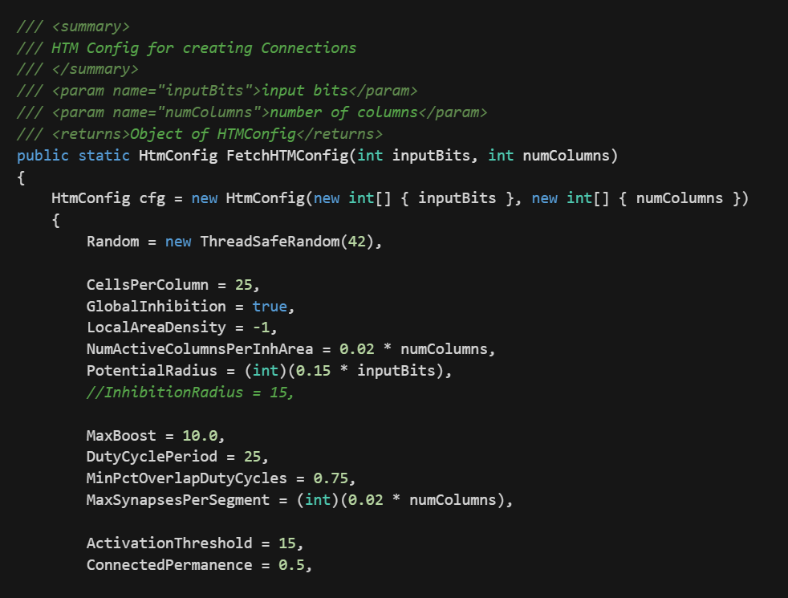
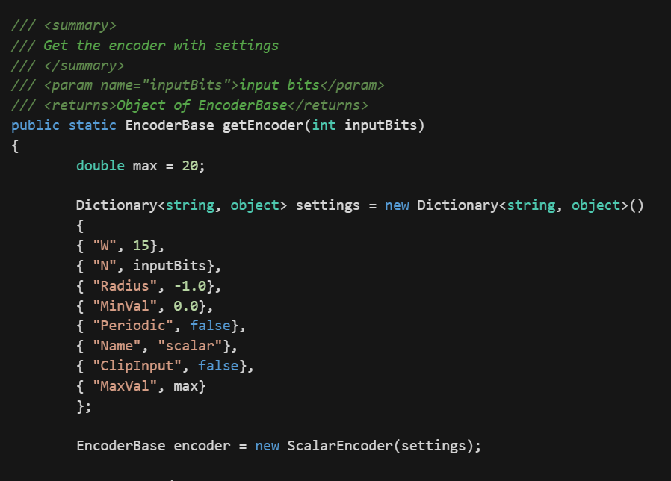
IMPLEMENTATION: METHODS
Fetch-HTM Config()
Get Encoder()

Slide 15
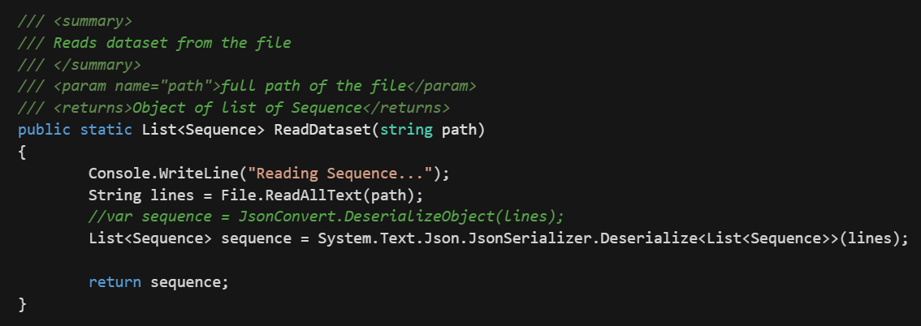
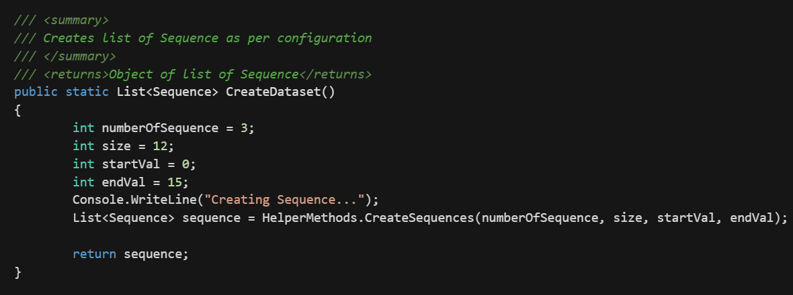
IMPLEMENTATION: METHODS
Read Dataset()
Create Dataset()

Slide 16
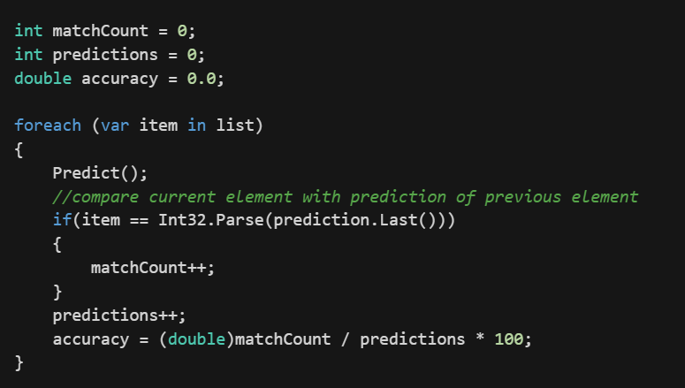
IMPLEMENTATION: CALCULATING ACCURACY
Calculating accuracy in PredictNextElement()

Slide 17
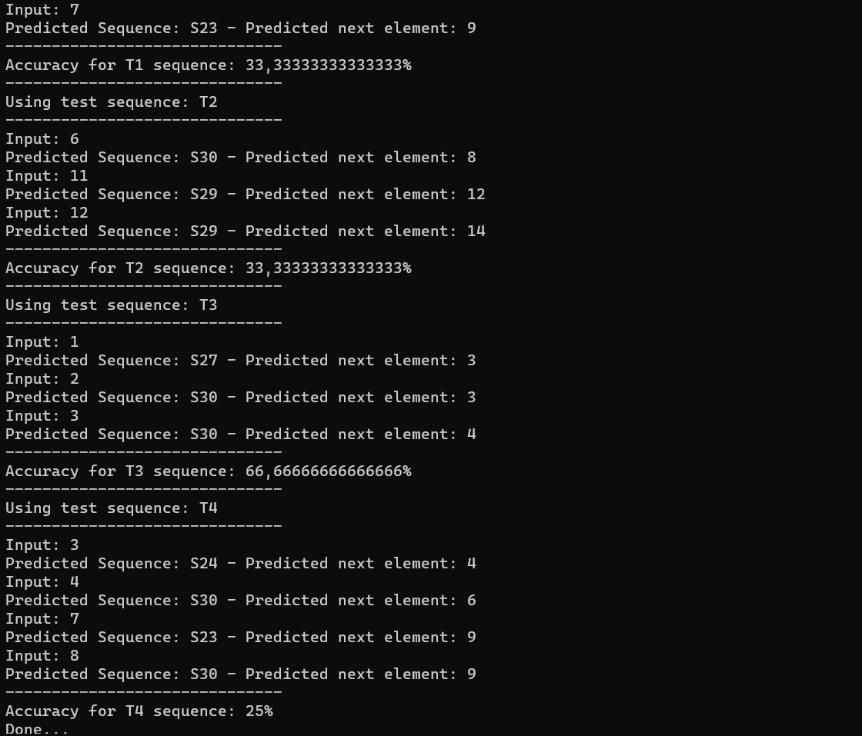
RESULTS
Among all the tests carried out in the instruction phase and forecast phase, the resemblances between patterns of the same class and various classes have clarified our results in the examples listed below.
We used Multi succession Learning to predict a succession of data points with high accuracy. The accuracy was shown to increase with the amount of cycles.

Slide 18
CONCLUSION
The Neocortex API’s multi-sequence learning template was used to provide a solution for multi-sequence learning of a sequence of integers. The HTM Prediction Engine was configured with numerous settings to fit the training process. The Multi-Sequence of Numbers was recorded, turned into an encoded value, and stored in a dictionary for training utilising an encoder and SDR input. To forecast the trained sequences, an algorithm was developed that compared the resulting similarity grid to each of the learnt sequence's SDRs from the training phase. The sequence was then predicted using the accuracy and observation class (Label), and the accuracy % of the expected sequences was determined and saved to a file.

Slide 19
REFERENCES:
Jeff Hawkins, "On Intelligence: How a New Understanding of the Brain will Lead to the Creation of Truly Intelligent Machines", 2004
B. H. J. L. R. .Rabiner, “An introduction to hidden Markov models,”," 1986. [Online]. Available: http://ai.stanford.edu/~pabbeel/depth_qual/Rabiner_Juang_hmms.pdf
Yudhi Adhitya,” IoT and Deep Learning-Based Farmer Safety System” 2023.[Online]. Available: https://www.researchgate.net/figure/Hierarchical-Temporal-Memory-HTM-algorithm-flowchart_fig2_369126441
Keele, "Sequence learning,” - B. A. C. G. J. D. S. W.," 1998. [Online]. Available: https://pubmed.ncbi.nlm.nih.gov/21227209/

Slide 20
Thank You

